Slide 1
Stock Market Analysis
An Analysis of Historical Stock Prices and Volume

Slide 2
Agenda
Introduction
Data Collection
Exploratory Data Analysis
Feature Engineering
Model Building and Evaluation
Deployment
Challenges Faced
Conclusion

Slide 3
INTRODUCTION
Stock market analysis is performed to make informed investment decisions, manage risks, and understand market behavior. Here are some key reasons why it's important:
Informed Investment Decisions: Analyzing the stock market helps investors identify which stocks to buy, hold, or sell. By understanding market trends, company performance, and economic indicators, investors can make better decisions to maximize returns.
Risk Management: Market analysis helps in identifying potential risks and enables investors to take precautions, such as diversifying their portfolios or using hedging strategies to minimize potential losses.
Identifying Market Trends: By analyzing historical data and market trends, investors can predict future market movements. This helps in capitalizing on opportunities when the market is likely to rise or taking protective measures when it's expected to fall

Slide 4
4. Valuation of Stocks: Fundamental analysis helps in assessing whether a stock is overvalued, undervalued, or fairly valued based on the company’s financial health and market conditions.
5. Economic Indicator: The stock market often reflects the overall economic health. Analyzing the market can provide insights into broader economic trends, such as inflation, interest rates, and GDP growth.
6. Algorithmic Trading: For automated trading systems, market analysis is crucial. It allows the development of algorithms that can execute trades based on pre-determined criteria, often with the goal of outperforming the market.

Slide 5
7. Sentiment Analysis: Understanding market sentiment, which can be gleaned from news, social media, and other sources, helps investors gauge the emotional tone of the market and predict short-term movements.
8. Portfolio Management: Regular market analysis helps in the ongoing management of investment portfolios, ensuring they are aligned with the investor’s goals and risk tolerance.
In summary, stock market analysis is a critical tool for investors and traders to navigate the complexities of the financial markets, maximize profits, and minimize risks.

Slide 6

DATA COLLECTION AND OVERVIEW

Slide 7

The SBI stock data is extracted from yahoo finance.com
Stock data typically consists of various key metrics that provide insights into the performance of a particular stock over time. Below are the common components included in stock data:
The data consists of 5100 rows and 7 columns
The columns contain :
Date : The date of the stock record
Open : Opening price of the stock
High : Highest price of the stock during the day
Low : Lowest price of the stock during the day
Close : Closing price of the stock
Volume : Number of shares traded

Slide 8
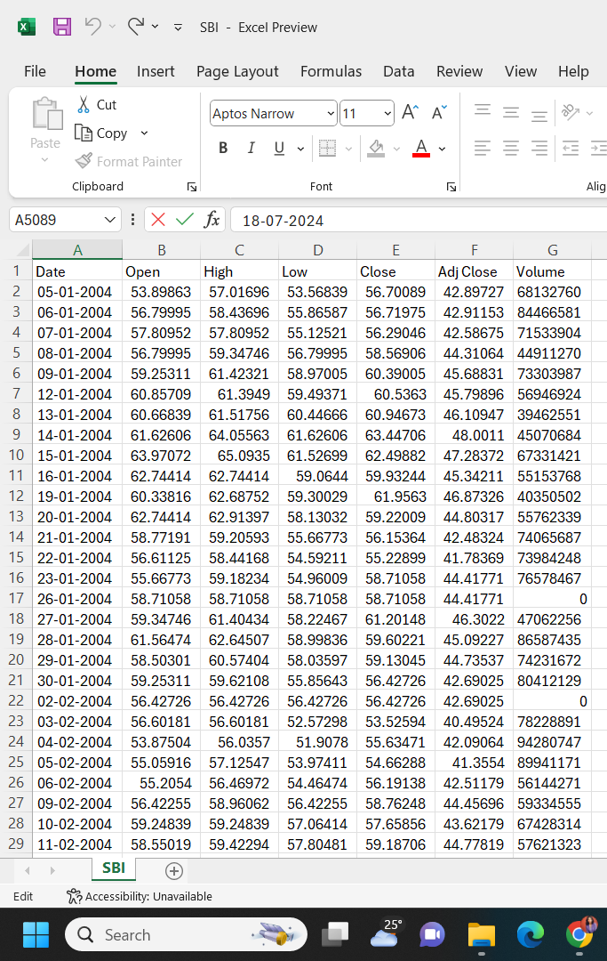
Why These Components Matter:
Open, High, Low, Close Prices: These give a snapshot of the stock’s price movement throughout the trading day, helping to identify trends, volatility, and patterns.
Volume: Provides insight into the liquidity of the stock. High trading volume indicates that the stock is actively traded and may be more liquid.
Adjusted Close Price: Helps in analyzing the performance of the stock over time while considering factors like dividends, which directly affect shareholder returns.

Slide 9

Exploratory Data Analysis

Slide 10
What is EDA?
Exploratory Data Analysis (EDA) is the process of analyzing and visualizing data to discover patterns, spot anomalies, test hypotheses, and check assumptions using statistical summaries and graphical representations. It's a critical first step in data analysis that helps in understanding the data's structure, underlying patterns, and relationships.

Slide 11
Steps to be performed in EDA
Understanding the Data
Data Cleaning
Finding any missing values
Locating outliers in the data
Categorize values
Data Visualization

Slide 12
1. Understanding the Data
Load the Data: Start by loading the dataset into a Pandas Data Frame.
Preview the Data: Use df.head() and df.tail() to get a sense of the data.
Check Data Types: Use df.info() to inspect data types and detect any potential issues with the data (e.g., dates not properly recognized as datetime).
Summary Statistics: Use df.describe() to generate summary statistics for numerical columns.

Slide 13
2. Data Cleaning
Handle Missing Values :
Check for missing values using df.isnull().sum().
The data consists of total 64 missing values.
Except the date column the other columns contain each of 9 missing values.
Convert Date Column :
Convert the “Date” column to “datetime” format using “pd.to_datetime()” if it’s not already in the format

Slide 14
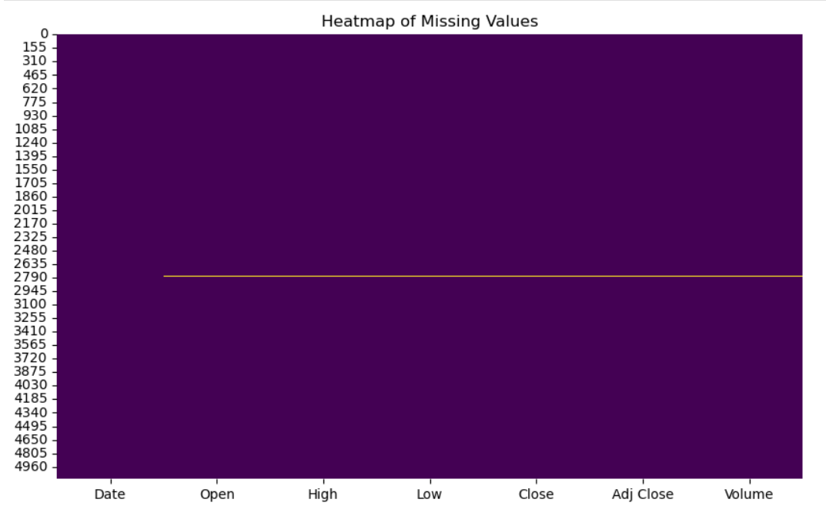

Slide 15
Locating Outliers in the Data

Slide 16
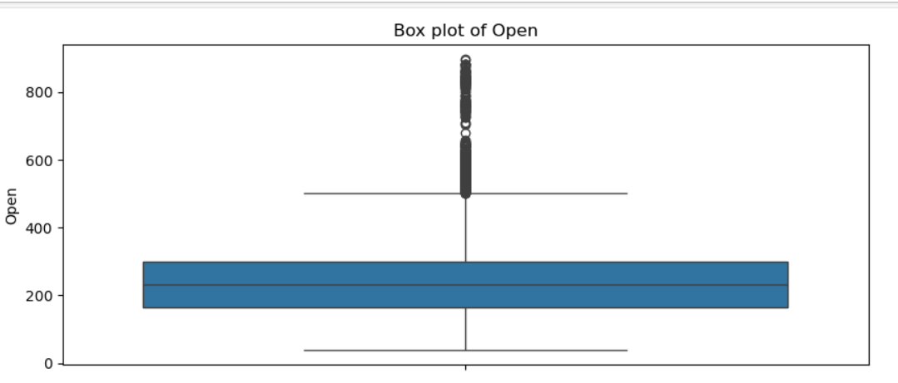
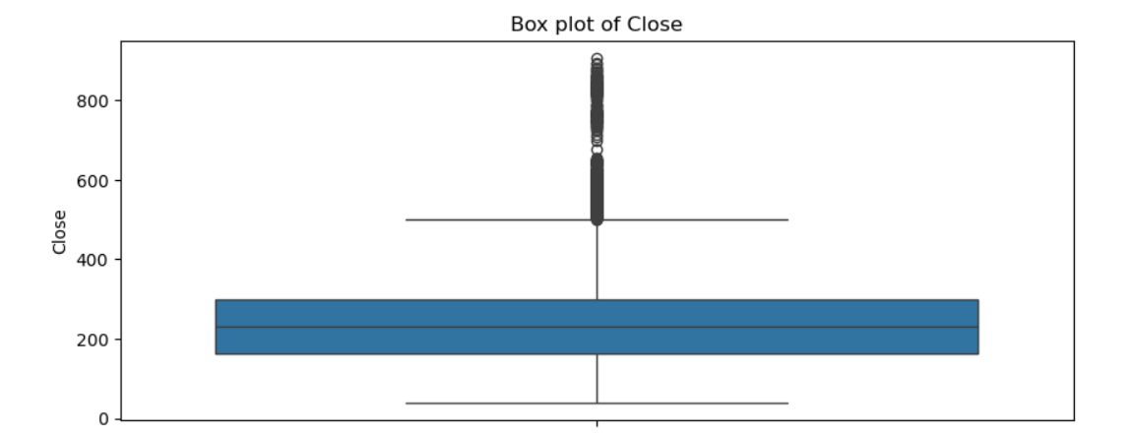
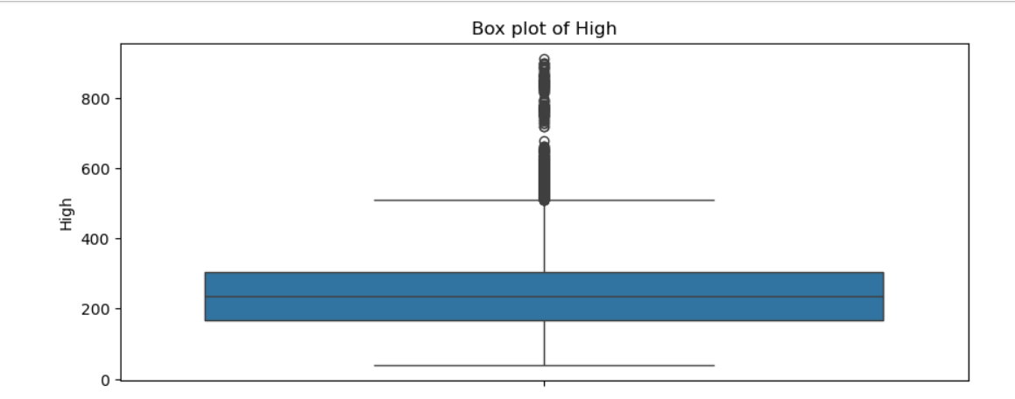
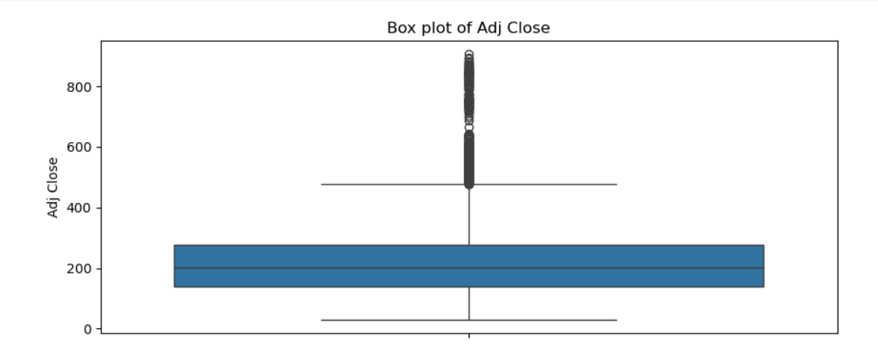
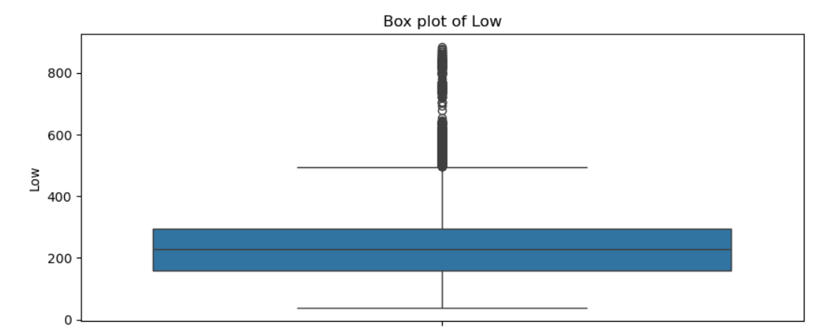
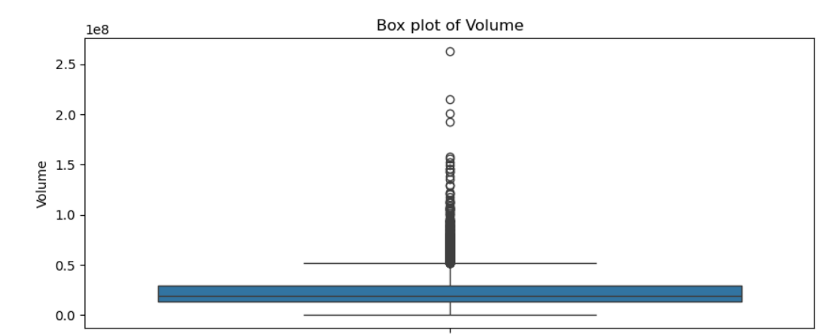

Slide 17
Categorize values
After you find any missing values, you can categorize your values to help determine what statistical and visualization methods can work with your dataset. You can place your values into these categories:
Categorical: Categorical variables can have a set number of values.
Continuous: Continuous variables can have an infinite number of values.
Discrete: Discrete variables can have a set number of values that must be numeric.

Slide 18
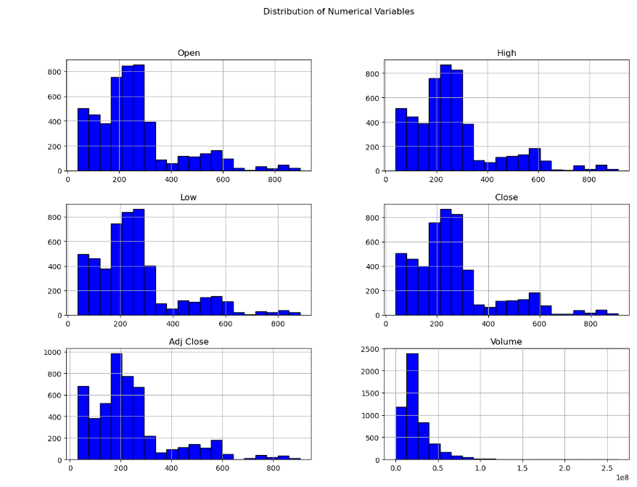
Distribution of Numerical Variables

Slide 19
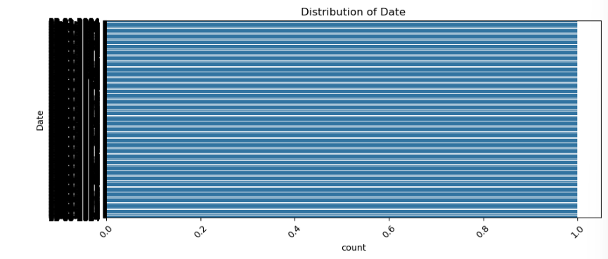
Distribution of Categorical variables

Slide 20

Data Visualizations

Slide 21
WHAT IS DATA VISUALIZATION ?
Data Visualization is the graphical representation of data and information using visual elements like charts, graphs, maps, and infographics. It transforms complex data into a visual format that is easier to understand and interpret, enabling quick insights and better decision-making.

Slide 22
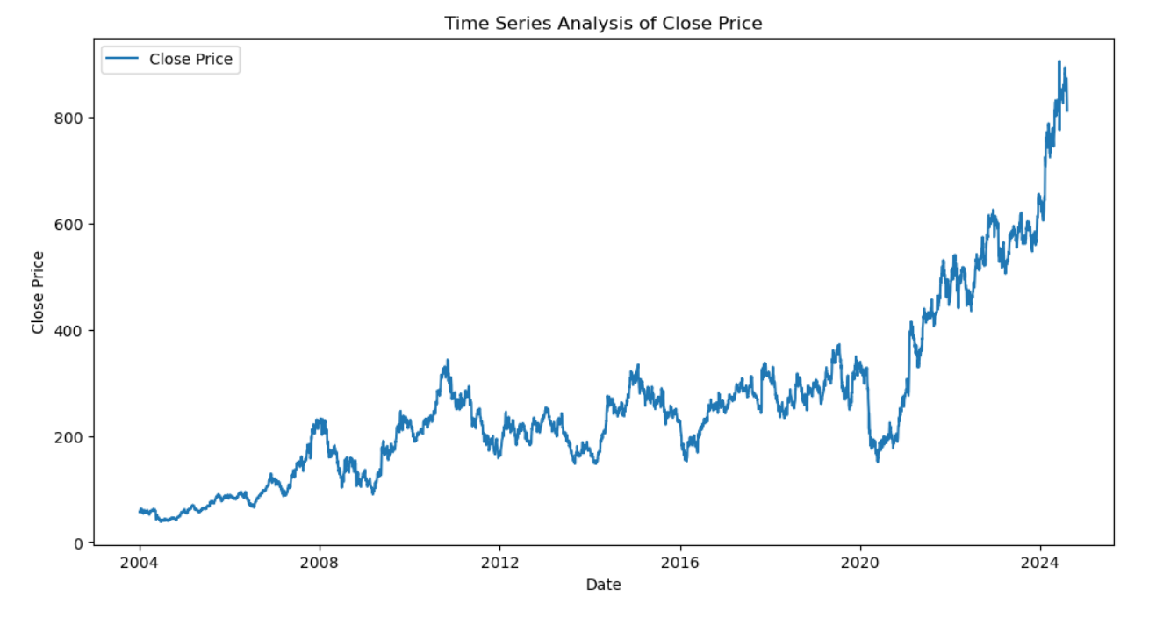
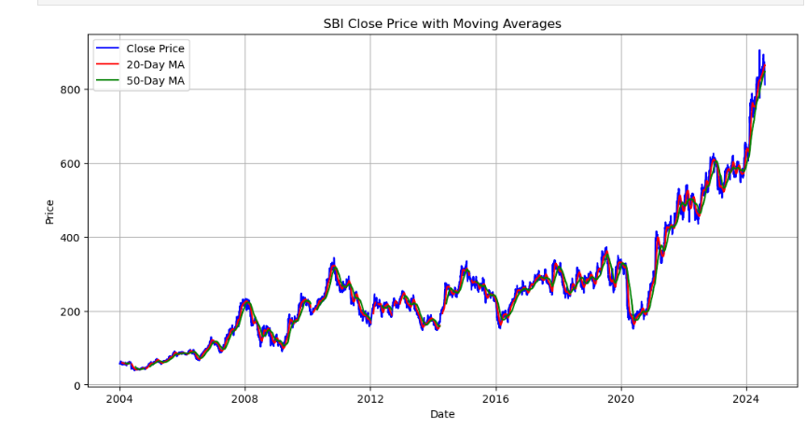
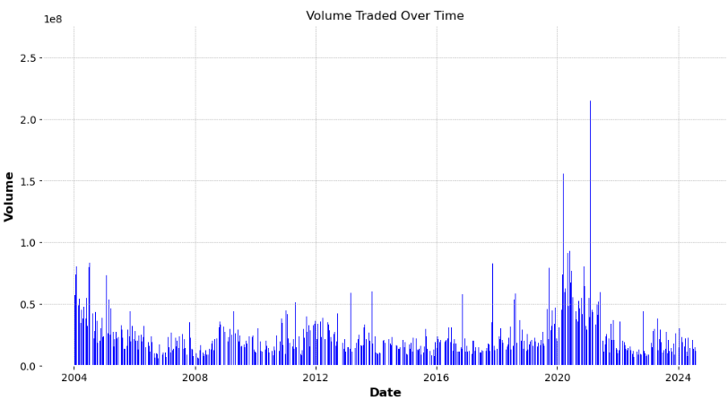

Slide 23
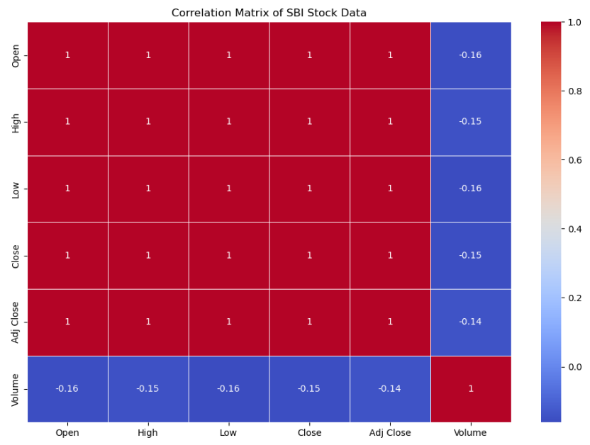
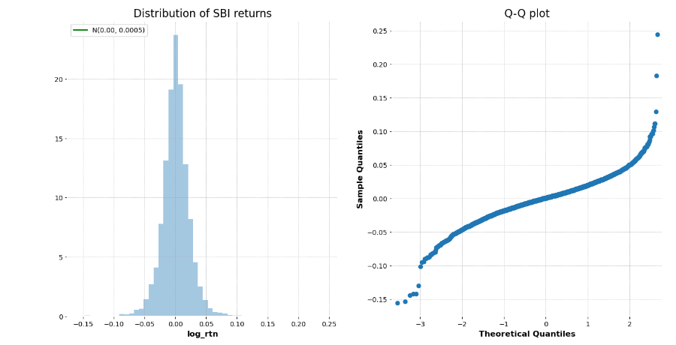
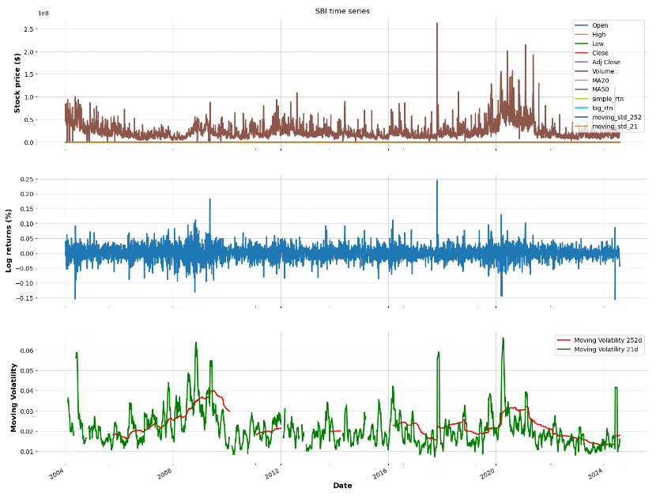

Slide 24
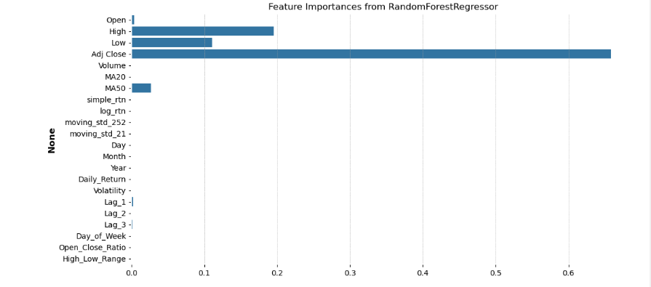
Feature Engineering
In Feature engineering we extracted day, month, and year from the data and displayed the new columns.
We calculated the daily returns and moving averages from the new column.
We also calculated the volatility and created the lag features from given Columns.
We also performed the One-hot encoding of the Day_of_week column. We also created the interaction features from above data and performed standardization.
Also the correlation beteen features is also done
Also trained the model using random forest and displayed and plotted .the feature importances

Slide 25
Model Building and Model Evaluation

Slide 26
In model building we tried different techniques such as :
ARIMA
Linear Regression
Random Forest
Support Vector Machine(SVR)
LSTM
FBPROPHET Model

Slide 27
ARIMA MODEL
The ARIMA (AutoRegressive Integrated Moving Average) model is a widely used statistical method for time series forecasting. It is particularly effective for analyzing and predicting data that show patterns over time, such as stock prices, sales data, or economic indicators. ARIMA is suitable for univariate time series data, meaning it forecasts future values based solely on past observations of the same variable.

Slide 28
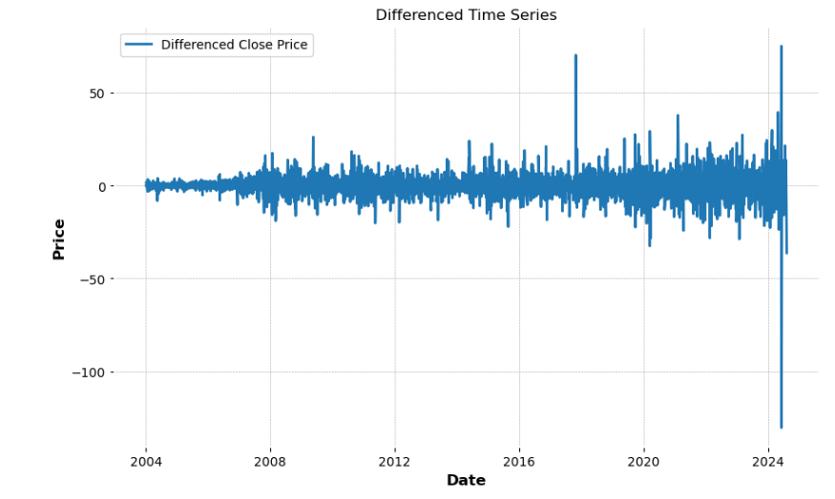
In this we first converted date column to datetime format with the correct format and performed Augmented Dickey-Fuller test.
And then differentiated the data
Then we plotted the ACF and PACF to determine p and q and built and fit the ARIMA model on training data.
We made predictions on test data and calculated the RMSE values.
And then we performed coding for the forecast future values and plotted the results for actual vs forecasted values.
Finally we performed hyperparameter tuning for ARIMA models.
The value for rmse is 359.697961112645

Slide 29
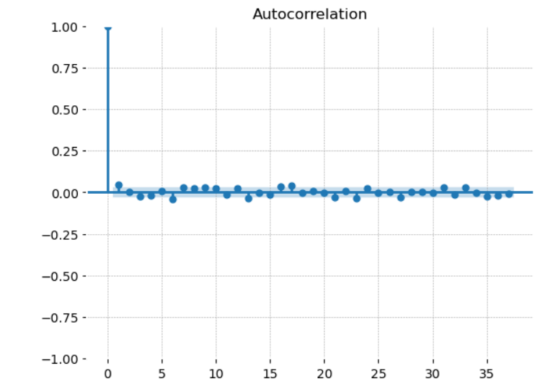
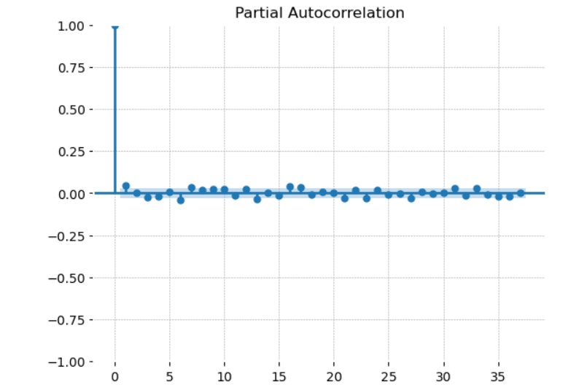
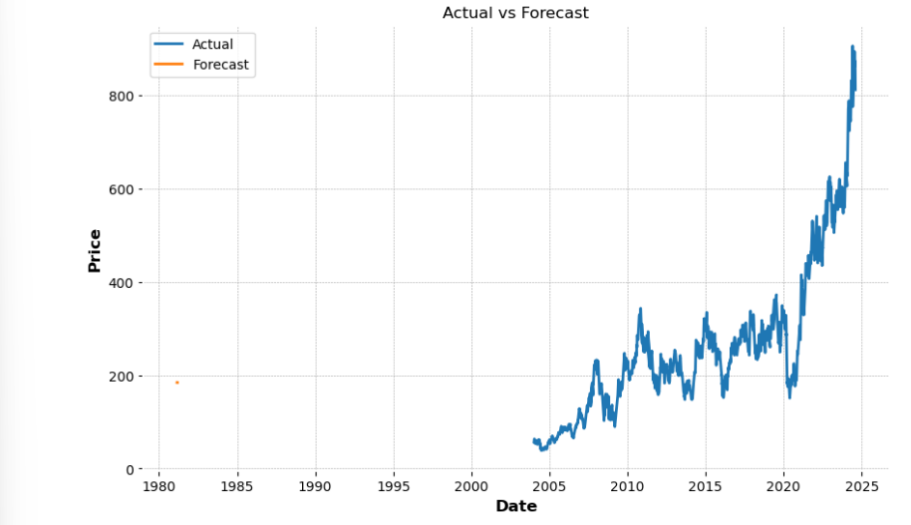

Slide 30
Linear Regression
Linear regression is a simple and widely used statistical method for modeling the relationship between a dependent variable (also called the target or outcome) and one or more independent variables (also called predictors or features). The goal of linear regression is to predict the value of the dependent variable based on the values of the independent variables.

Slide 31
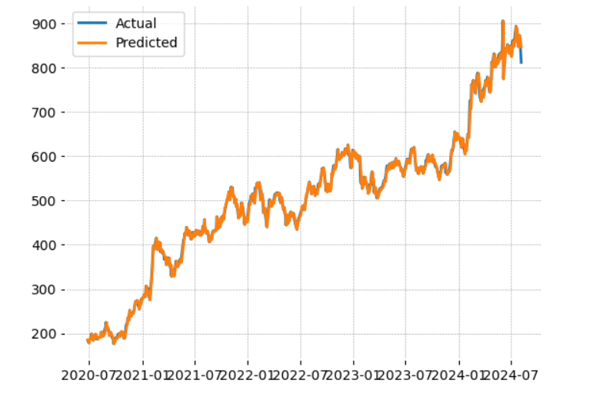
In this model we first prepared the data for the regression and split the data into test and training sets and built the regression model.
Then performed the cross-validation for time series models using LR and found the mse and rmse values.
Then after than we predicted and evaluated the results and plotted the results for Linear Regression based on Actual vs Predicted values.
The values for mse and rmse are :
Mean Squared Error : 43.49524558491265
Root Mean Squared Error : 6.2480402968069395

Slide 32
Random Forest
Random Forest is a powerful and versatile machine learning algorithm that is widely used for both classification and regression tasks. It belongs to the family of ensemble learning methods, which combine the predictions of multiple models to improve accuracy and robustness.

Slide 33
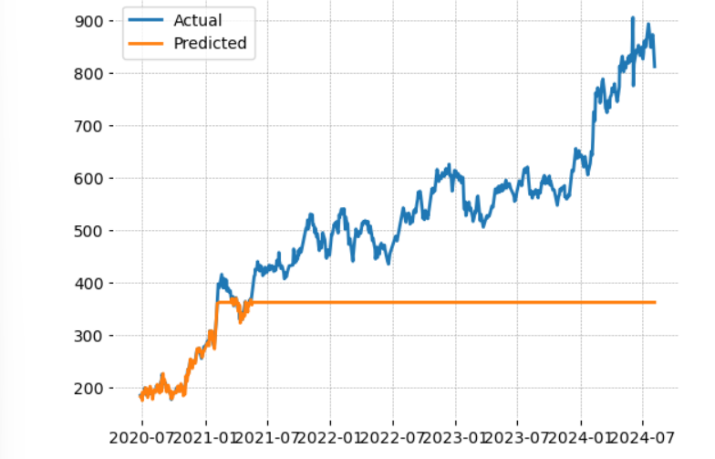
In this model we first split the data into test and training sets.
Then build the random forest model.
Then after than we predicted and evaluated the results for mse and rmse values and then plotted the actual vs predicted values.
The values for mse and rmse are :
Mean Squared Error : 44311.424494545594
Root Mean Squared Error : 10.081599752457905

Slide 34
Support Vector Machine(SVM)
Support Vector Machine (SVM) is a supervised machine learning algorithm commonly used for classification and regression tasks. It is especially effective for high-dimensional spaces and cases where the number of dimensions exceeds the number of samples. SVM is known for its robustness in handling both linear and non-linear data.

Slide 35
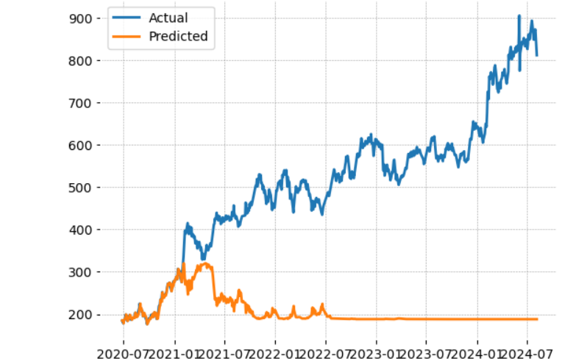
In this model we first split the data into test and training sets.
Then build the SVM model.
Then after than we predicted and evaluated the results for mse and rmse values and then plotted the actual vs predicted values.
The values for mse and rmse are :
Mean Squared Error : 122050.90228348927
Root Mean Squared Error : 10.081599752457905

Slide 36
Long Short-Term Memory(LSTM)
Long Short-Term Memory (LSTM) is a type of recurrent neural network (RNN) architecture specifically designed to model and learn from sequences of data, making it particularly effective for time series forecasting, natural language processing, and other tasks involving sequential information. LSTMs are a key component in many deep learning applications due to their ability to capture long-term dependencies in data.

Slide 37
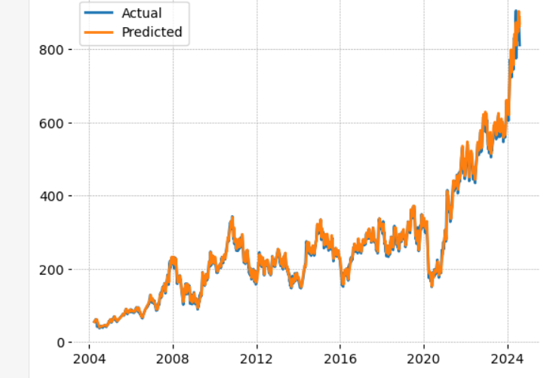
In this model we scale the data, and created the training data.
Then build the LSTM model.
Then after than we predicted and visualized the results

Slide 38
FaceBookProphet(Fbprophet)
Facebook Prophet is a forecasting tool developed by Facebook’s Core Data Science team. It’s designed for forecasting time series data, particularly when the data has strong seasonal patterns and missing values. Here’s a brief overview:
Purpose: It’s used for forecasting future values based on historical time series data. It’s particularly useful for business forecasting like sales, stock prices, and other metrics that have seasonal patterns.

Slide 39
In this model we first load the data and convert the date column to date time format.
As prophet requires the data to have two specific columns named “ds” for the date and “y” for the close column, we renamed them as required.
Then we initialized the prophet model and created a dataframe to hold future dates.
Then after than we made predicted and displayed the forecasted values
Then we plotted the forecast and components of the forecast.
Finally calculated the prophet model mean squared error value which is around 1172.3120227541524

Slide 40
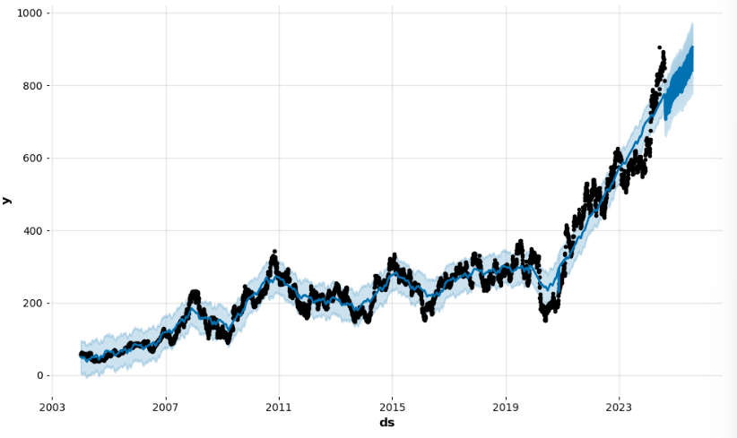
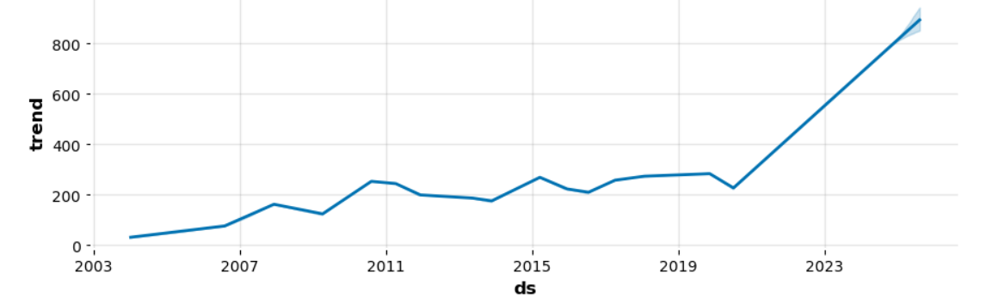
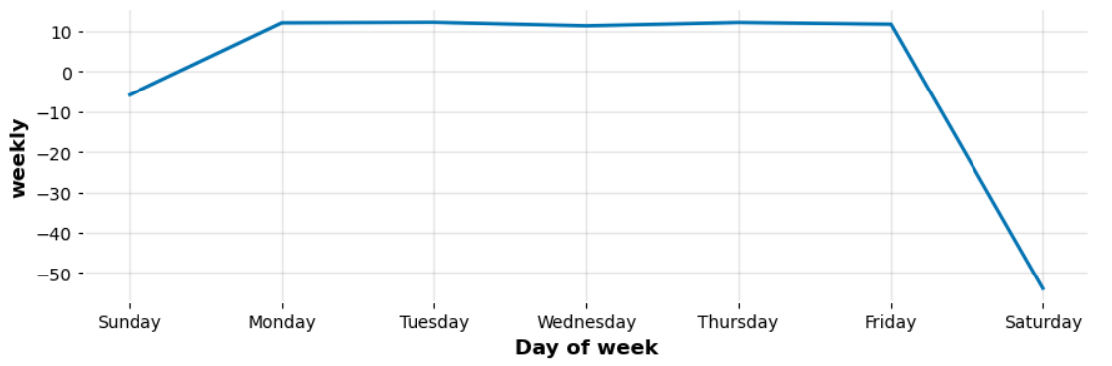
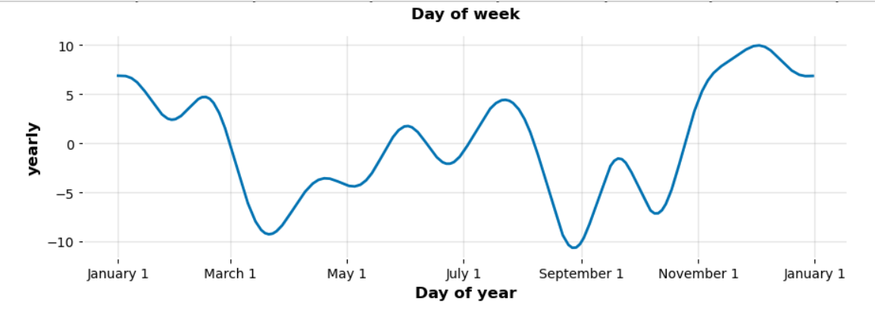

Slide 41
Model Deployment

Slide 42
Model deployment is the process of making a machine learning model available for use in a production environment. Here’s why it’s done:
Utilize Model Insights
Real-Time Predictions
Automation
Scalability
User Integration
Continuous Improvement
Business Value
Overall, deployment is a crucial step in leveraging the benefits of machine learning models in real-world scenarios.

Slide 43

In model deployment we deployed model based on ARIMA model using “STREAMLIT”.
We used Visual Studio Code for coding for the deployment
Using the SBI stock data we predicted the future prices and then plotted the future price predictions using this Stremlit app
We create and code in the app.py file and then deploy it under streamlit for the results.

Slide 44
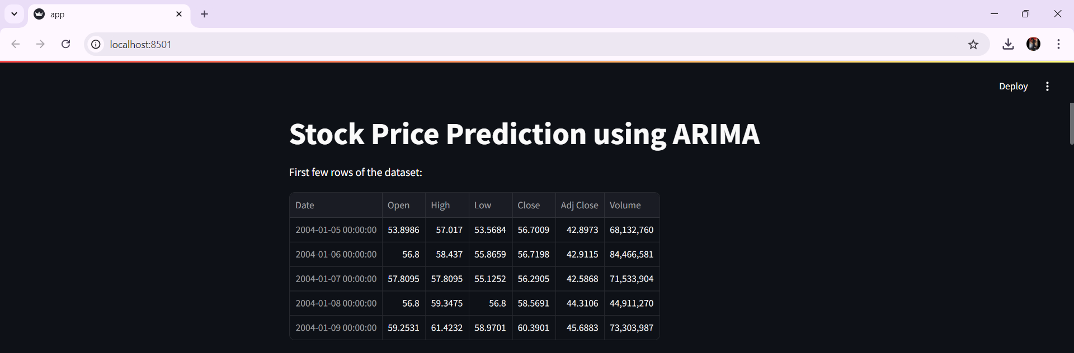
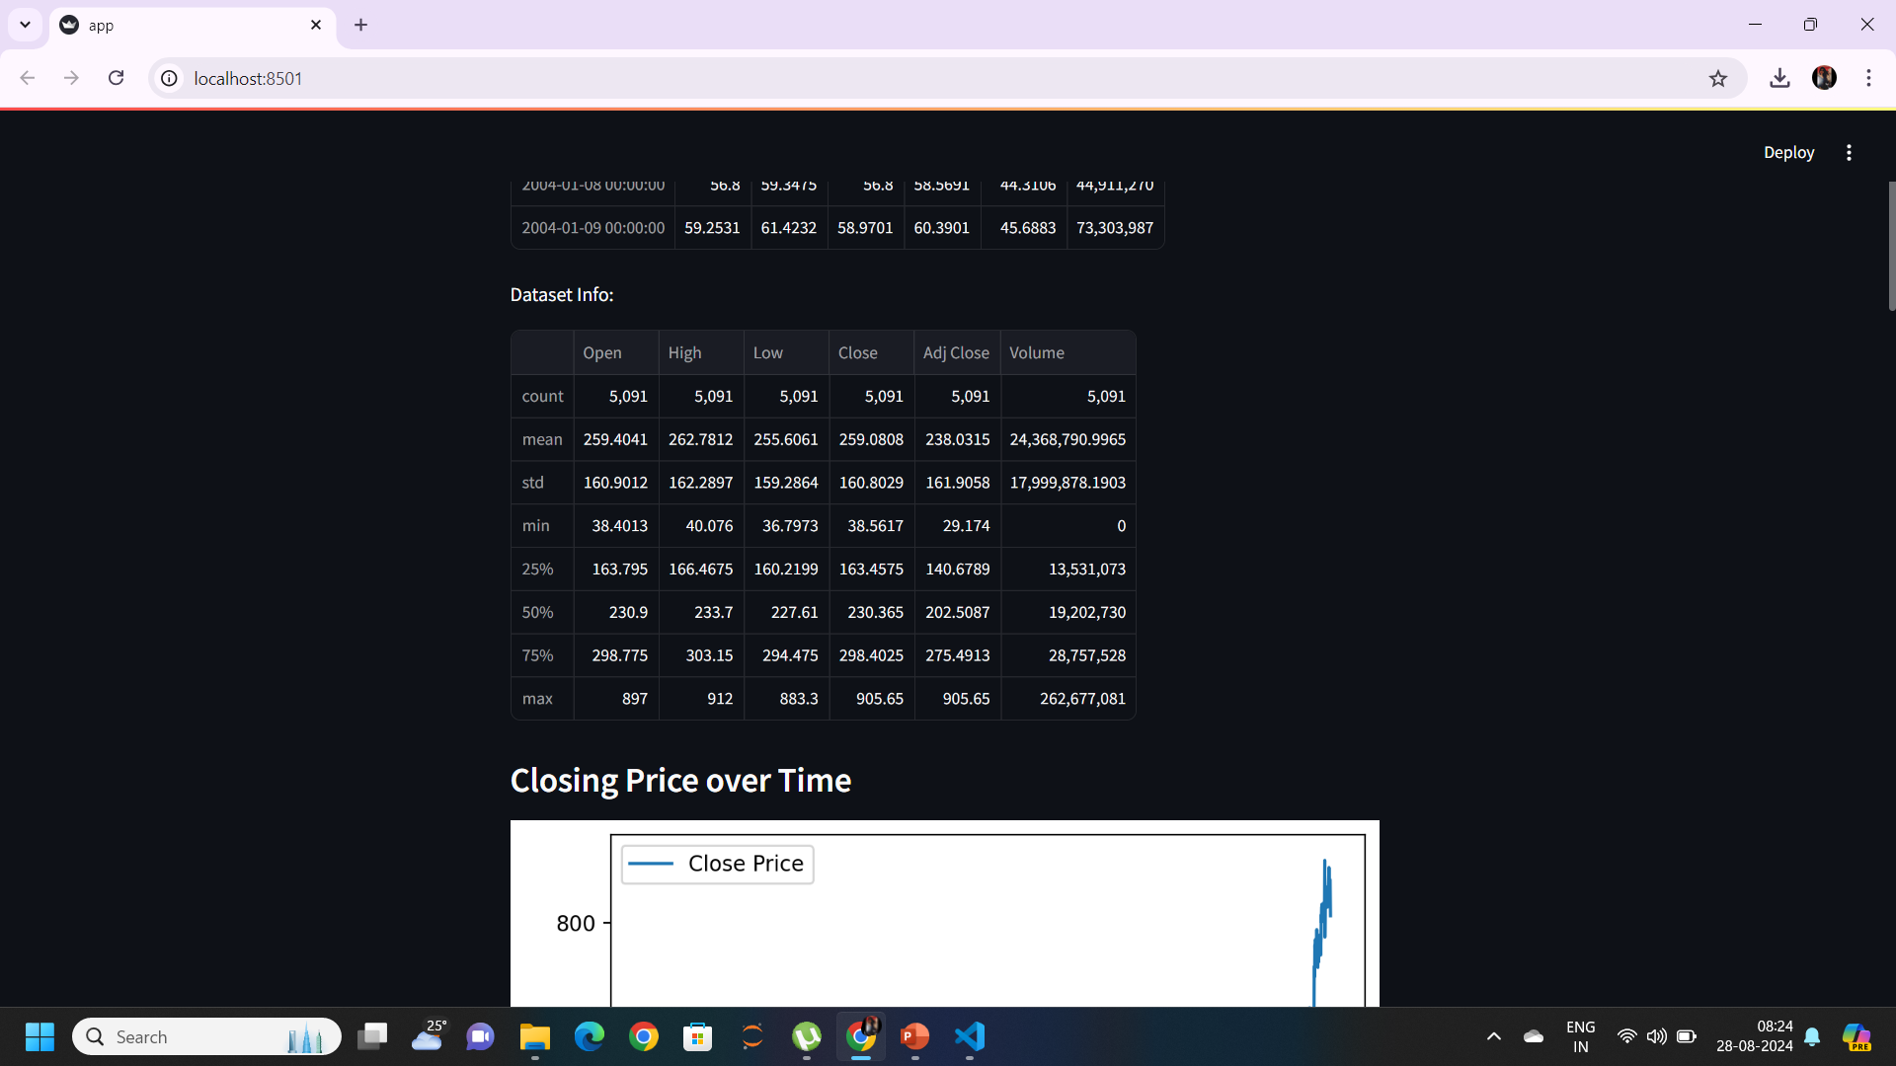

Slide 45
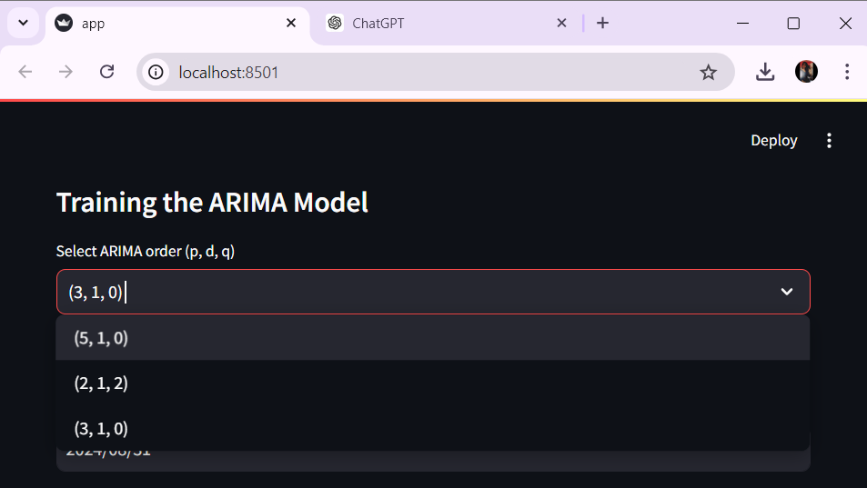
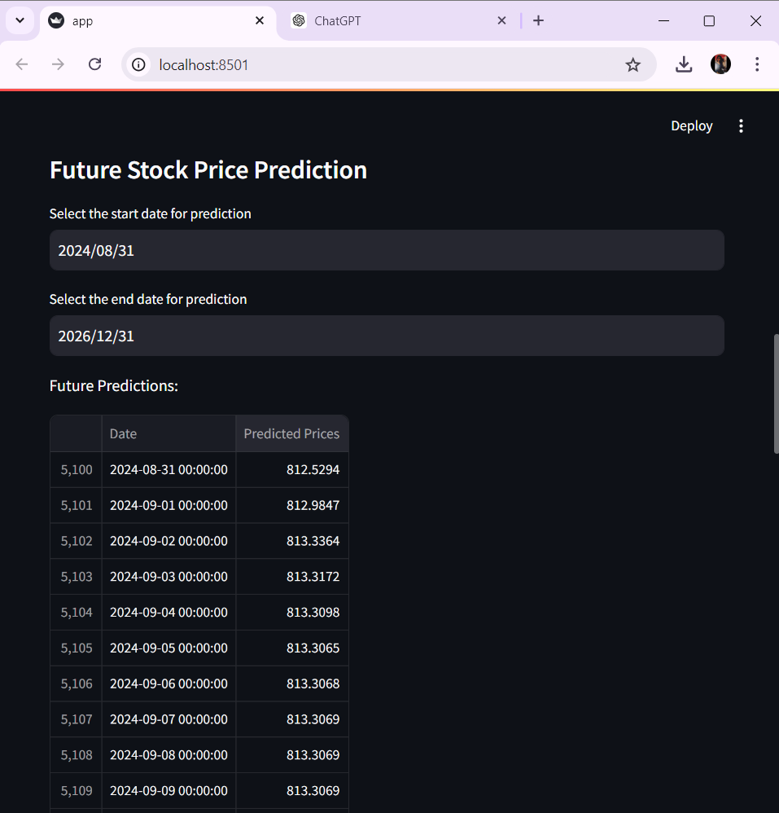

Slide 46
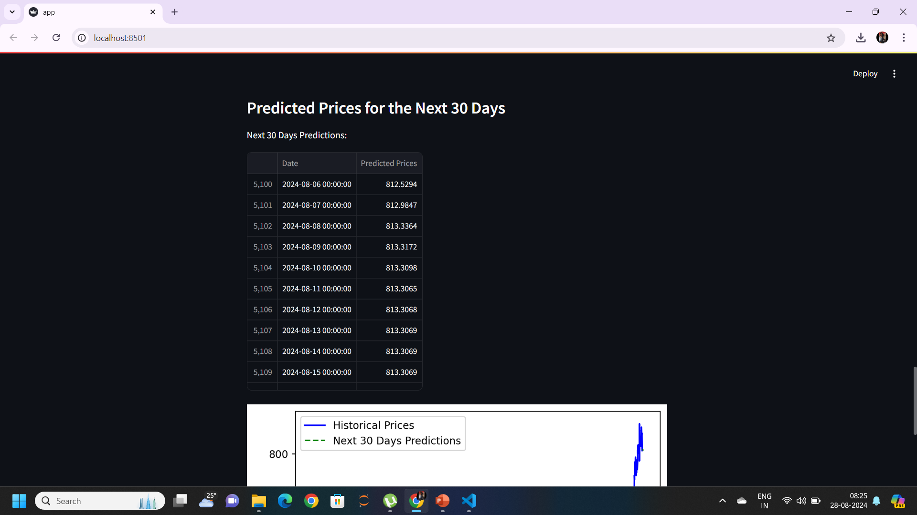

Slide 47
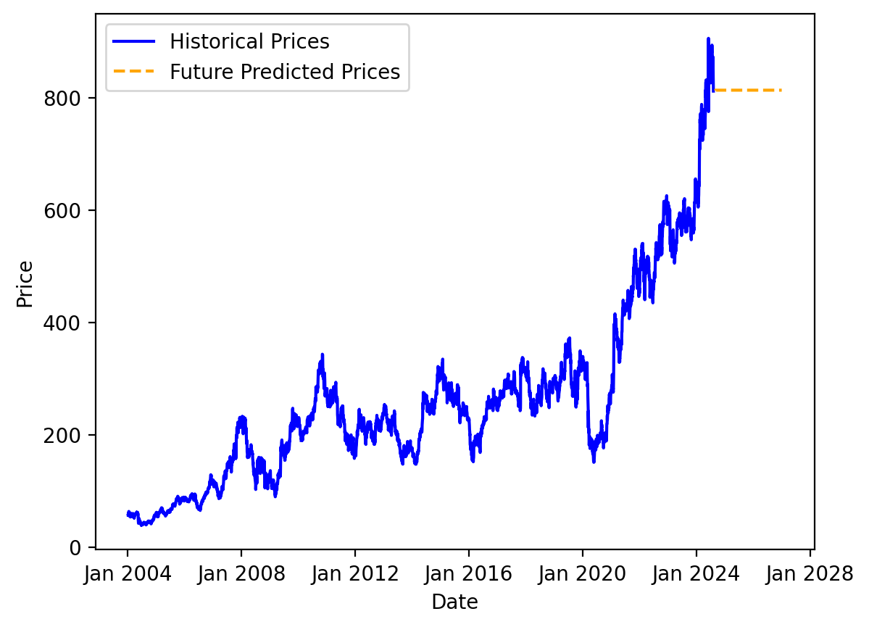
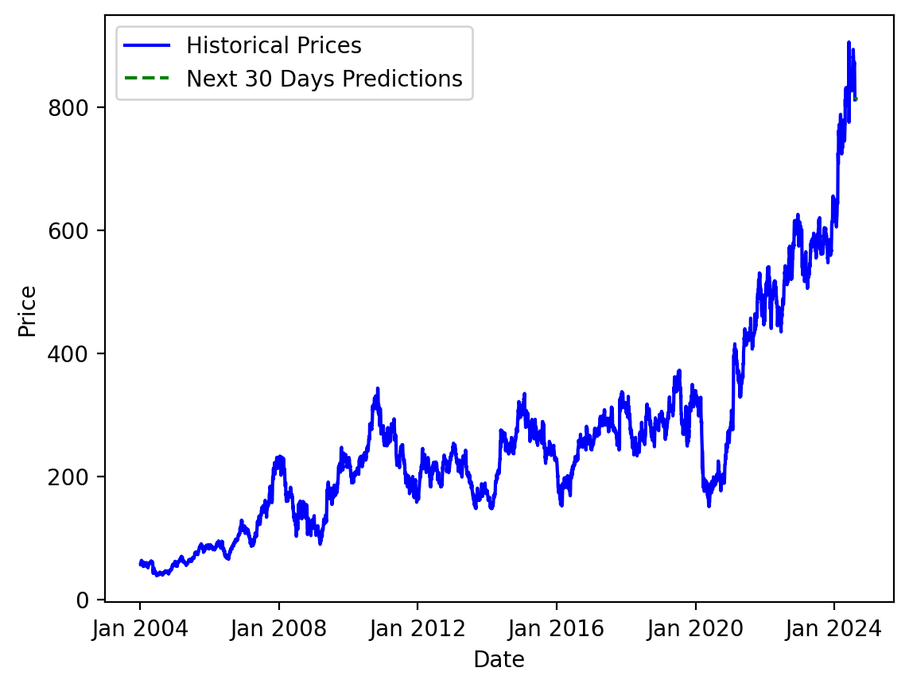

Slide 48

Challenges Faced
Analyzing stock data, such as that of the State Bank of India (SBI), involves several challenges that can affect the accuracy and reliability of the analysis. Here are some common challenges faced in SBI stock data analysis:
1. Data Quality Issues:
Missing Data: Stock data might have missing values for certain days or time periods, especially during holidays or market closures, leading to gaps in the dataset.
Inaccurate Data: Errors in recorded prices, volumes, or other metrics can lead to misleading analysis if not detected and corrected.
2. High Volatility:
Market Volatility: Stock prices can fluctuate widely within short periods due to various factors, making it difficult to identify clear trends or predict future movements.
Impact of External Events: Unforeseen events such as economic downturns, political instability, or global crises (e.g., pandemics) can cause sudden and unpredictable changes in stock prices.
3. Model Selection and Tuning:
Overfitting: When building predictive models, especially using complex algorithms like ARIMA, Facebook Prophet, or Machine Learning models, there is a risk of overfitting to historical data, leading to poor future predictions.
Model Complexity: Selecting the right model and tuning it for accuracy without making it overly complex is a delicate balance.

Slide 49
4. Real-time Analysis:
Data Latency: In real-time stock analysis, data latency can affect the timeliness and accuracy of predictions.
Algorithm Responsiveness: Ensuring that algorithms are responsive to real-time data updates without introducing significant delays is a technical challenge.
5. Visualization and Interpretation:
Complex Data Representation: Effectively visualizing stock data, trends, and predictions, especially for non-expert users, can be challenging.
Interpretation: Interpreting complex graphs and forecasts, particularly when dealing with probabilistic models, requires skill and experience.
These challenges require careful consideration and handling to conduct a robust and insightful analysis of SBI stock data.

Slide 50

CONCLUSION
The analysis of SBI stock data provides valuable insights into the historical performance and future trends of one of India's largest and most influential banks.
By addressing challenges such as data quality, market volatility, and model selection, we can derive meaningful conclusions that guide investment decisions.
While predictive models like ARIMA and Facebook Prophet offer robust forecasting capabilities, they require careful tuning and validation to avoid overfitting and ensure accuracy. Additionally, recognizing seasonal patterns and adjusting for them enhances the reliability of the predictions.
In conclusion, SBI's stock analysis highlights the importance of comprehensive data handling, careful model selection, and an understanding of broader market dynamics. Investors should use the insights gained from this analysis to make informed decisions, while also staying vigilant of market conditions and continuously refining their strategies based on new data and emerging trends.

Slide 51
Thank you

